Slide 1
Inventory Manager
By: Justin Harlow

Slide 2
Overview
The Store Inventory Manager program was made to help the user keep track of supplies and products within a store. It helped categorized them to their aisles and the quantity of product.
It utilizes a class and inheritance.
Parent class is Inventory.
Child Class are aisles in the front of the store.

Slide 3
Objectives
The objectives of the project are as follows;
Create a functional and simple program for updating and tracking a stores inventory.
The method chosen is using a class system where the parent class (Inventory) is the store’s backstock categorized by aisles the product goes to.
The child classes are the aisles in which products go to and the product in each aisle is made into a list.
Every list in the parent class has a complementary child class.

Slide 4
Outcome
The outcome is great however the original intention was to have user input and when adding product to a child class (aisle) it would take product out of the associated list in the parent class (Inventory).
However due to time constraints on my end I made several commands that correspond with each Child Class (Aisle) and the Parent Class lists.
This relies on the user’s ability to do math and track shipments.

Slide 5
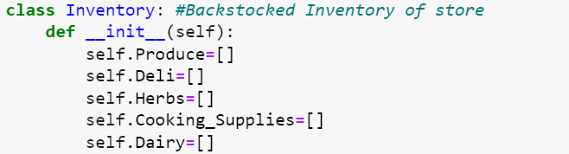
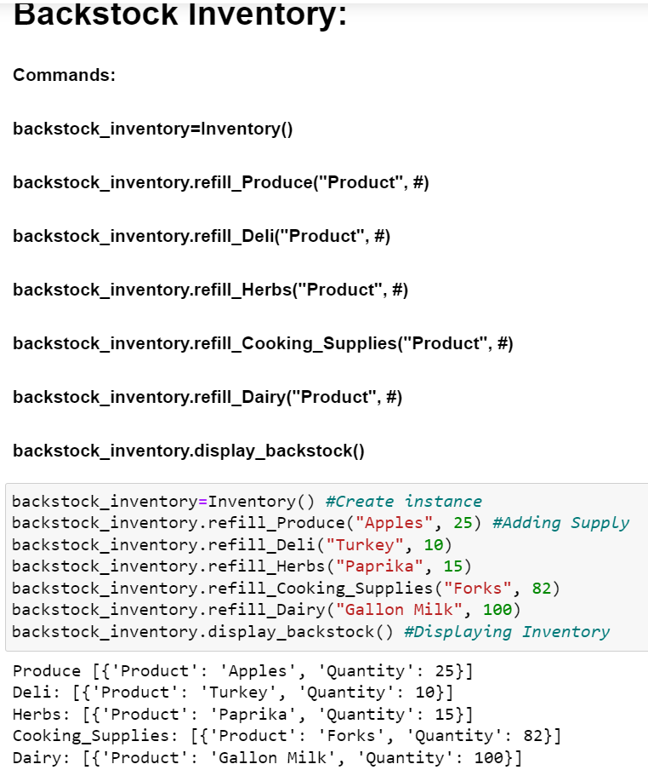
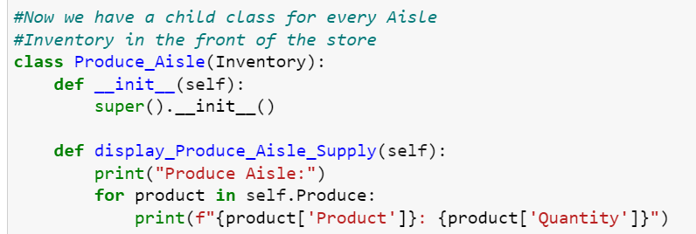
Results/ Output
The design is like how a store is laid out, backstock is pulled and placed in its associated aisle. Parent class (Inventory) to Child Class (Aisle). Def was used to make commands that “Refilled” and “Display” product either in backstock or in the aisle.

Slide 6
Working principle- Demo
https://github.com/J-Harlow/Final-Individual-Project

Slide 7
Challenges and Solutions
The biggest challenge for me is time otherwise I would have liked to make a more robust program that did what I had originally wanted.
I was able to make functional program that would work but relies on the user’s math and shipment tracking abilities, through commands.

Slide 8
Discussion
The outcome was satisfactory but not all that I wanted. The program relies on commands and not user input.
If I had to improve anything it would be the application of code that allowed for pulling the quantity of products from parent class to child class and then a command for resupplying backstock.
Other than that I had completed what I set out to do and that was a class system inventory manager that is simple and can easily be built upon.

Slide 9
References
Matthes, Eric. Python Crash Course: A Hands-on, Project-Based Introduction to Programming. No Starch Press, 2023.
Sarkar, Sayani. “CS-150 Notebooks and Lectures.” CS-150. CS-150, Bellarmine University, Bellarmine University.

Slide 10
Thank You

